Slide 1
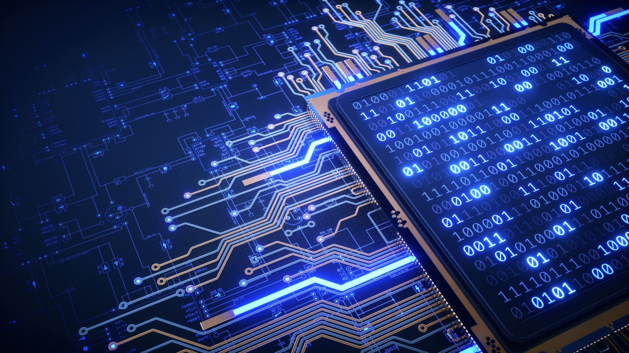
Virtual Systems and Services
Instructor Name: Fahad Burhan Ahmad

Slide 2
Contents
Introduction & Background
Understanding virtualization
What is virtualization?
How does virtualization work?

Slide 3
Introduction & Background
Fundamental idea – abstract hardware of a single computer into several different execution environments
Like layered approach
But layer creates virtual system (virtual machine, or VM) on which operating systems or applications can run
Several components
Host – underlying hardware system
Virtual machine manager (VMM) or hypervisor – creates and runs virtual machines by providing interface that is identical to the host
(Except in the case of paravirtualization)
Guest – process provided with virtual copy of the host
Usually, an operating system
Single physical machine can run multiple operating systems concurrently, each in its own virtual machine

Slide 4
System Models
Non-virtual machine
Virtual machine
Operating-system-like software built to provide virtualization, including VMware ESX, Joyent SmartOS, and Citrix XenServer.

Slide 5
What is Virtualization?
vir•tu•al (adj): existing in essence or effect,
though not in actual fact
Virtual systems
Abstract physical components using logical objects
Dynamically bind logical objects to physical configurations
Examples
Network – Virtual LAN (VLAN), Virtual Private Network (VPN)
Storage – Storage Area Network (SAN), Logical unit number
Computer – Virtual Machine (VM), simulator

Slide 6
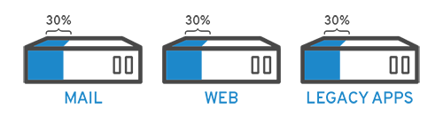
What is Virtualization?
Virtualization is technology that lets you create useful IT services using resources that are traditionally bound to hardware.
It allows you to use a physical machine’s full capacity by distributing its capabilities among many users or environments.
In more practical terms, imagine you have 3 physical servers with individual dedicated purposes. One is a mail server, another is a web server, and the last one runs internal legacy applications.
Each server is being used at about 30% capacity—just a fraction of their running potential.
But since the legacy apps remain important to your internal operations, you must keep them and the third server that hosts them, right?

Slide 7
What is Virtualization?
Traditionally, yes. It was often easier and more reliable to run individual tasks on individual servers:
1 server, 1 operating system, 1 task.
It wasn’t easy to give 1 server multiple brains.
But with virtualization, you can split the mail server into 2 unique ones that can handle independent tasks so the legacy apps can be migrated. It’s the same hardware, you’re just using more of it more efficiently.

Slide 8
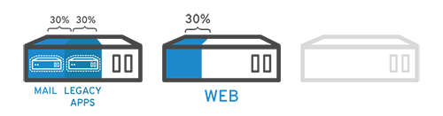
What is Virtualization?
Keeping security in mind, you could split the first server again so it could handle another task
—increasing its use from 30%, to 60%, to 90%.
Once you do that, the now empty servers could be reused for other tasks or retired altogether to reduce cooling and maintenance costs.

Slide 9
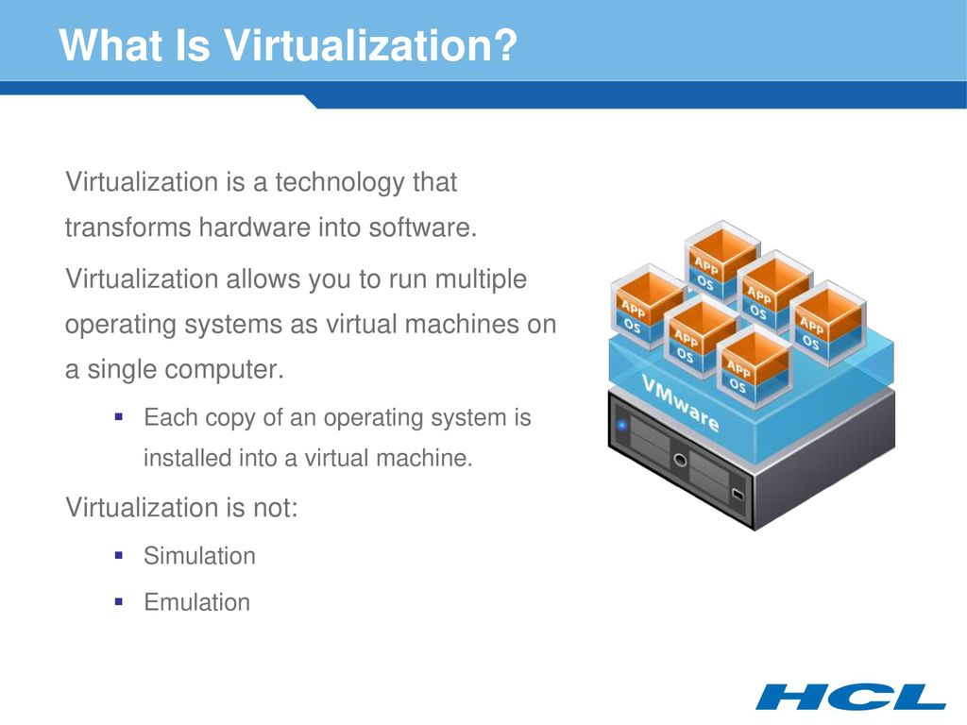
The main difference between Emulator and Simulator is that when an emulator has the basis of machine-level assembly language, simulators have the support of high-level machine language. Emulators are capable to replicate both software and hardware where simulators only mimic software and they cannot mimic hardware.

Slide 10
A brief history of virtualization
While virtualization technology can be sourced back to the 1960s, it wasn’t widely adopted until the early 2000s.
The technologies that enabled virtualization—like hypervisors—were developed decades ago to give multiple users simultaneous access to computers that performed batch processing.
Batch processing was a popular computing style in the business sector that ran routine tasks thousands of times very quickly (like payroll).
But, over the next few decades, other solutions to the many users/single machine problem grew in popularity while virtualization didn’t.
One of those other solutions was time-sharing, which isolated users within operating systems—inadvertently leading to other operating systems like UNIX, which eventually gave way to Linux®.
All the while, virtualization remained a largely unadopted, niche technology.

Slide 11
A brief history of virtualization
Fast forward to the the 1990s. Most enterprises had physical servers and single-vendor IT stacks, which didn’t allow legacy apps to run on a different vendor’s hardware.
As companies updated their IT environments with less-expensive commodity servers, operating systems, and applications from a variety of vendors, they were bound to underused physical hardware—each server could only run 1 vendor-specific task.
This is where virtualization really took off.
It was the natural solution to 2 problems:
companies could partition their servers and run legacy apps on multiple operating system types and versions.
Servers started being used more efficiently (or not at all), thereby reducing the costs associated with purchase, set up, cooling, and maintenance.

Slide 12
A brief history of virtualization
First appeared in IBM mainframes in 1972
Allowed multiple users to share a batch-oriented system
Formal definition of virtualization helped move it beyond IBM
• Fidelity. A VMM provides an environment for programs that is essentially identical to the original machine. • Performance. Programs running within that environment show only minor performance decreases. • Safety. The VMM is in complete control of system resources.
In late 1990s Intel CPUs fast enough for researchers to try virtualizing on general purpose PCs
Xen and VMware created technologies, still used today
Virtualization has expanded to many OSes, CPUs, VMMs

Slide 13
A brief history of virtualization
For example, the open-source VirtualBox project (http://www.virtualbox.org)
A program that runs on Intel x86 and AMD 64 CPUs
Host OS
Windows, Linux, macOS, and Solaris host operating systems.
Possible guest operating systems
Windows, Linux, Solaris, and BSD, including even MS-DOS and IBM OS/2.
Virtualization’s widespread applicability helped reduce vendor lock-in and made it the foundation of cloud computing.
It’s so prevalent across enterprises today that specialized virtualization management software is often needed to help keep track of it all.

Slide 14
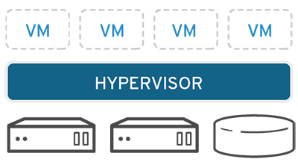
How does virtualization work?
Software called hypervisors separate the physical resources from the virtual environments—the things that need those resources.
Hypervisors can sit on top of an operating system (like on a laptop) or be installed directly onto hardware (like a server), which is how most enterprises virtualize.
Hypervisors take your physical resources and divide them up so that virtual environments can use them.

Slide 15
How does virtualization work?
Resources are partitioned as needed from the physical environment to the many virtual environments.
Users interact with and run computations within the virtual environment (typically called a guest machine or virtual machine).
The virtual machine functions as a single data file. And like any digital file, it can be moved from one computer to another, opened in either one, and be expected to work the same.
When the virtual environment is running and a user or program issues an instruction that requires additional resources from the physical environment, the hypervisor relays the request to the physical system and caches the changes—which all happens at close to native speed (particularly if the request is sent through an open-source hypervisor based on KVM, the Kernel-based Virtual Machine).

Slide 16
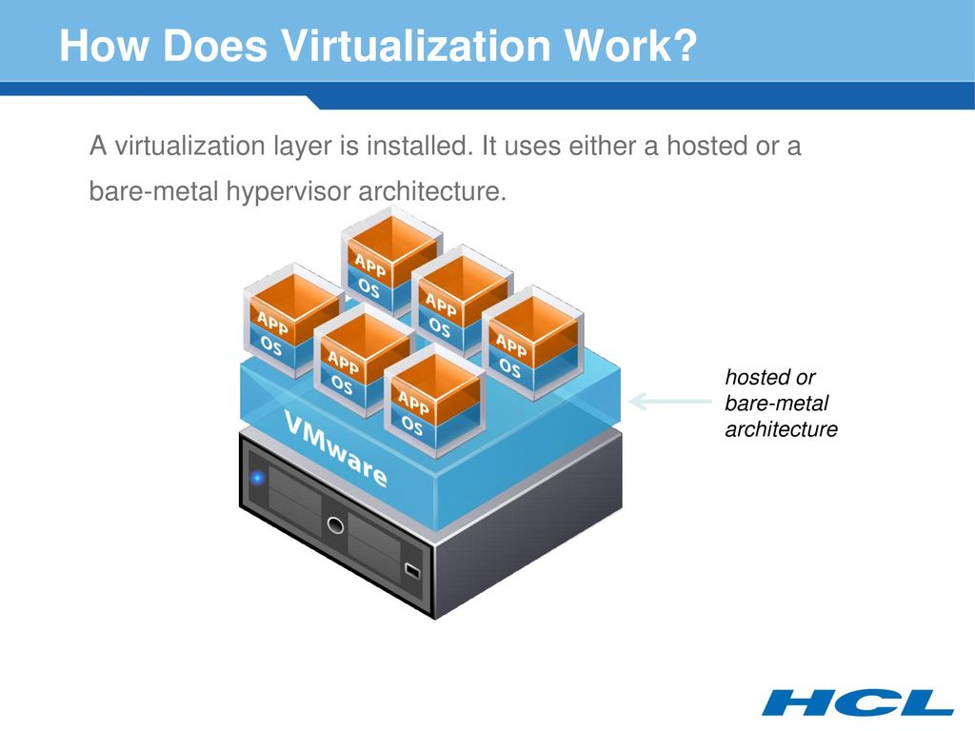

Slide 17
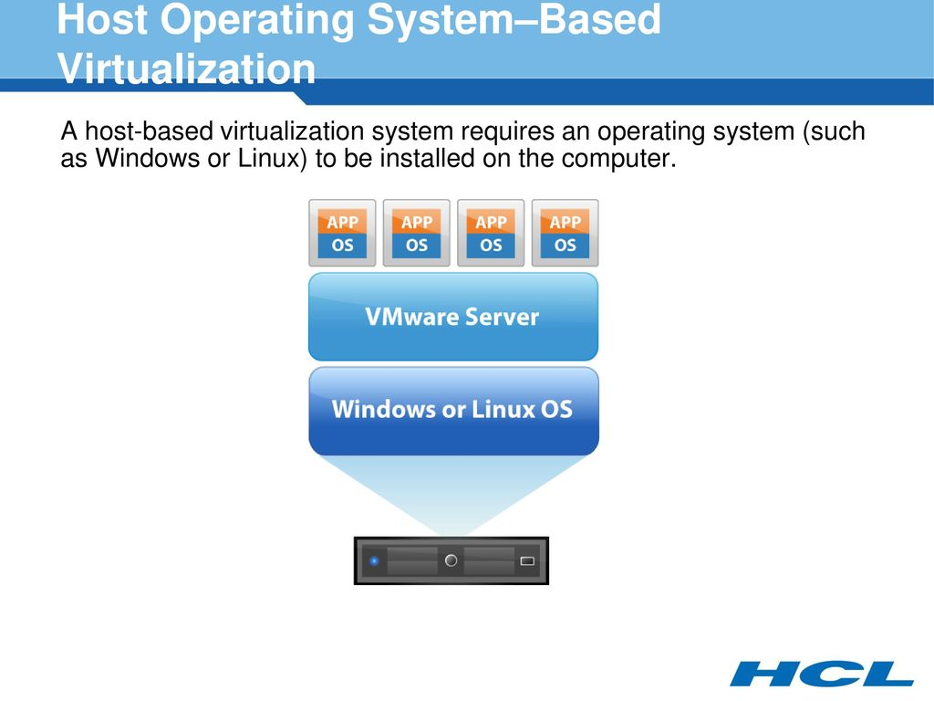

Slide 18
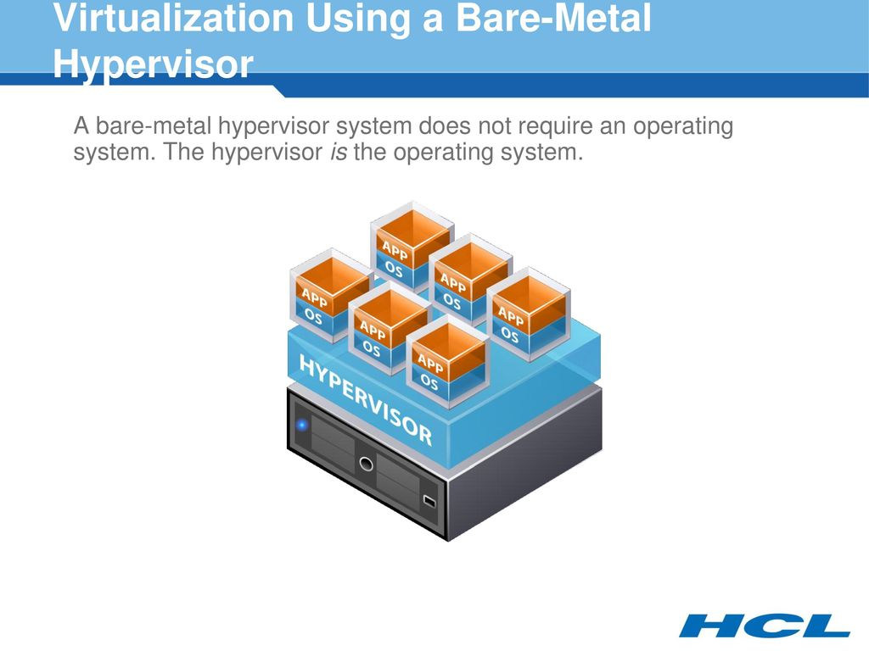

Slide 20
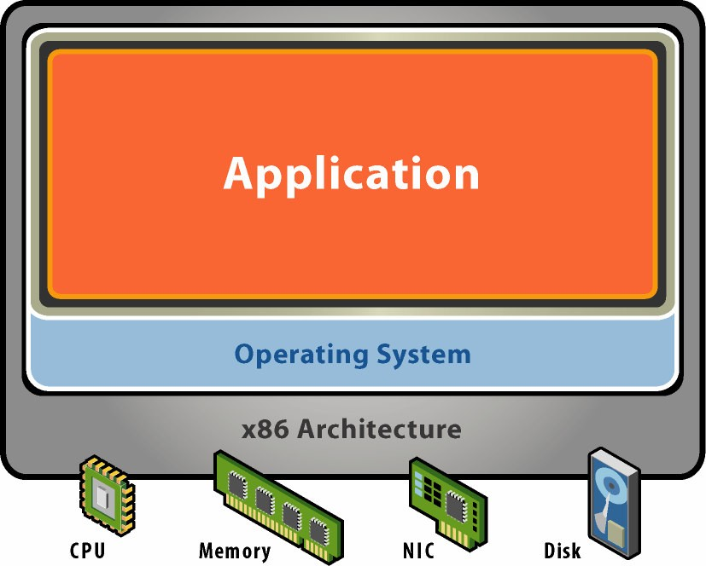
Starting Point: A Physical Machine
Physical Hardware
Processors, memory, chipset, I/O bus and devices, etc.
Physical resources often underutilized
Software
Tightly coupled to hardware
Single active OS image
OS controls hardware

Slide 21
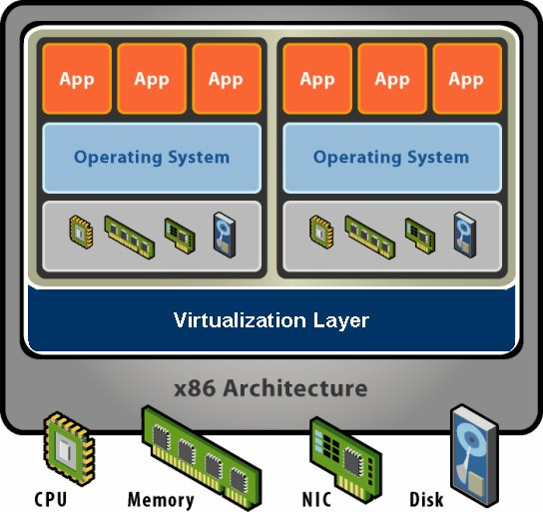
What is a Virtual Machine?
Hardware-Level Abstraction
Virtual hardware: processors, memory, chipset, I/O devices, etc.
Encapsulates all OS and application state
Virtualization Software
Extra level of indirection decouples hardware and OS
Multiplexes physical hardware across multiple “guest” VMs
Strong isolation between VMs
Manages physical resources, improves utilization

Slide 22
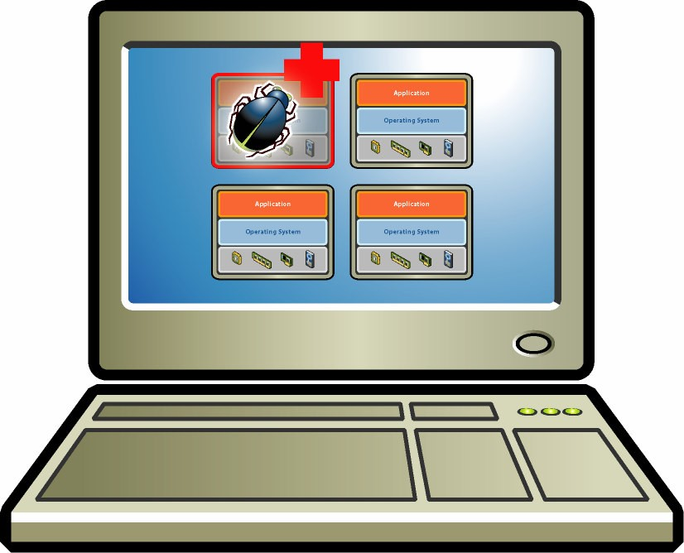
VM Isolation
Host system protected from VMs, VMs protected from each other
i.e., A virus less likely to spread
Sharing is provided though via shared file system volume, network communication
Secure Multiplexing
Run multiple VMs on single physical host
Processor hardware isolates VMs, e.g. MMU
Strong Guarantees
Software bugs, crashes, viruses within one VM cannot affect other VMs
Performance Isolation
Partition system resources
Example: VMware controls for reservation, limit, shares

Slide 23
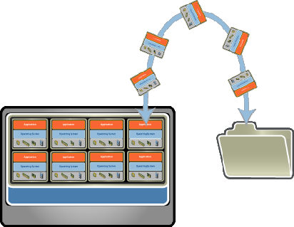
VM Encapsulation
Suspend, running VM
Then can move or copy somewhere else and resume
Snapshot of a given state, able to restore back to that state
Some VMMs allow multiple snapshots per VM
Clone by creating copy and running both original and copy
Entire VM is a File
OS, applications, data
Memory and device state
Snapshots and Clones
Capture VM state on the fly and restore to point-in-time
Rapid system provisioning, backup, remote mirroring
Easy Content Distribution
Pre-configured apps, demos
Virtual appliances

Slide 24
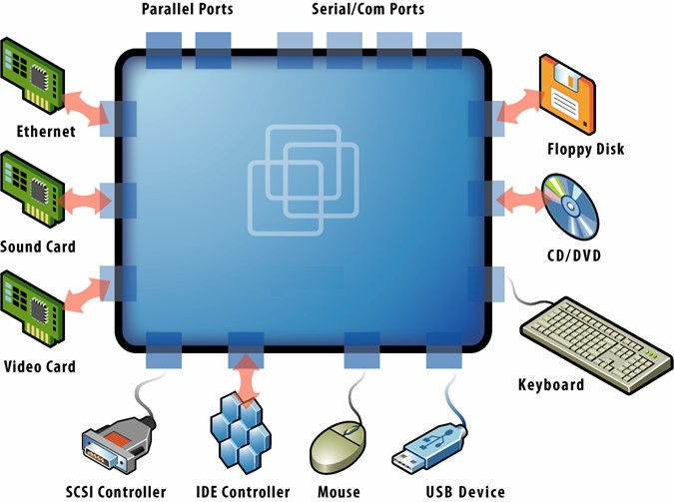
VM Compatibility
Great for OS research, better system development efficiency
Run multiple, different OSes on a single machine
Consolidation, app dev, …
Hardware-Independent
Physical hardware hidden by virtualization layer
Standard virtual hardware exposed to VM
Create Once, Run Anywhere
No configuration issues
Migrate VMs between hosts
Legacy VMs
Run antique OS on new platform
E.g. DOS VM drives virtual IDE and vLance devices, mapped to modern SAN and GigE hardware

Slide 25
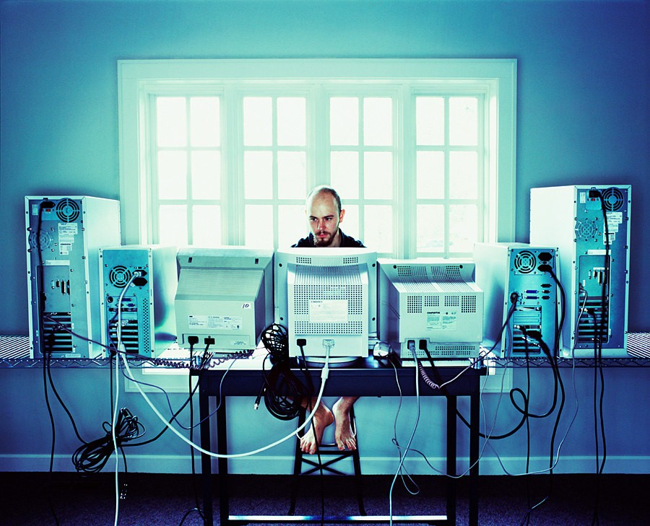
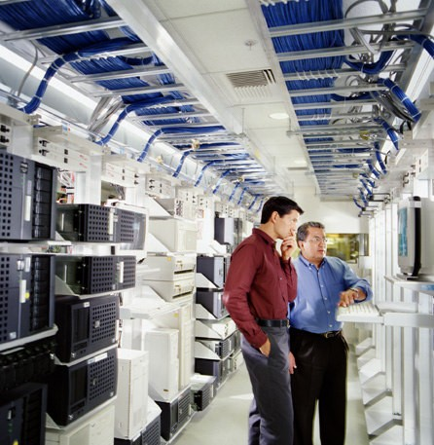
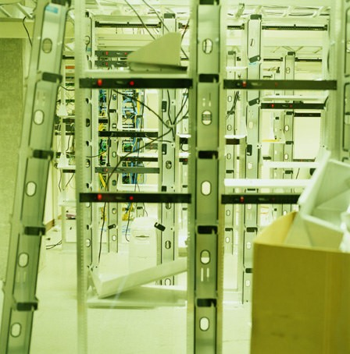
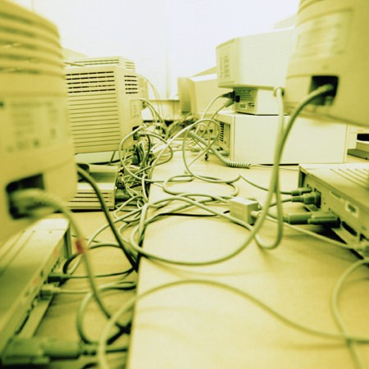
Common Virtualization Uses Today
Test and Development – Rapidly provision test and development servers; store libraries of pre-configured test machines
Server Consolidation and Containment – Eliminate server sprawl by deploying systems into virtual machines that can run safely and move transparently across shared hardware
Business Continuity – Reduce cost and complexity by encapsulating entire systems into single files that can be replicated and restored onto any target server
Enterprise Desktop – Secure unmanaged PCs without compromising end-user autonomy by layering a security policy in software around desktop virtual machines

Slide 26
References
Operating System Concepts 10th edition
By Abraham Silberschatz, Peter Baer Galvin
www.ibm.com
www.vmware.com

